Slide 1
React JS
(passing argument to event handler )
Lecture-21

Slide 2
Today’s Agenda
Passing Arguments To Event Handlers
Different Ways Of Passing Arguments
Examples
Shopping Cart Project

Slide 3
Argument Passing
To Event Handlers
When we work with a React component we can attach an event to onClick (or other events) as shown below:
<button onClick={this.showBill}>Show Bill</button>

Slide 4
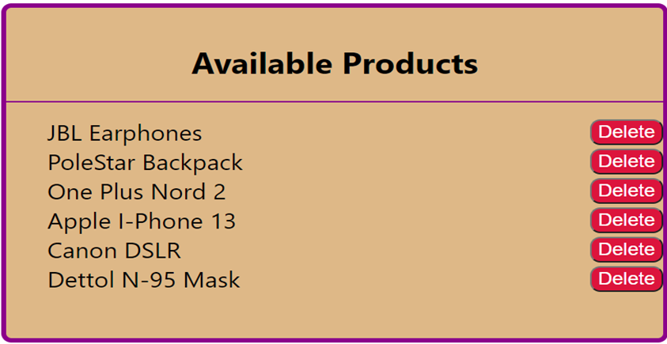
Argument Passing
To Event Handlers
But what if we have to pass an argument?
For example , suppose we have a list of products in a shopping cart, and we want to remove a particular product by clicking the “Delete Button” next to it.

Slide 5
Argument Passing
To Event Handlers
So , can we do this ?
<button onClick={this.removeFromCart(this.id)}>Delete</button>

Slide 6
Argument Passing
To Event Handlers
The answer is a BIG NO
This is because the expression inside onClick is going to be executed as soon as cart is rendered.
This is going to delete all the products in the cart, as soon as the Shopping Car is rendered.

Slide 7
Different Ways Of
Passing Arguments
React provides us three ways to pass arguments to event handler methods and they are:
Routing the call through a function
Passing arrow function to event props like onClick
Passing arguments to bind()

Slide 8
What About ‘e’ ?
In all cases, the e argument representing the react event will be passed as last argument .
With an arrow function, we have to pass it explicitly, but with bind(), any further arguments are automatically forwarded.

Slide 9
Routing Call Through A Function
In this approach we create two methods for event handling , as follows:
The first method will be non parametrized and will be set in onClick
The second method will be parametrized and will be called by the first method with appropriate arguments

Slide 10
Exercise
Create an app with the following files:
Student.js: This file should contain following members:
2 props called roll and name
handleClick() :Which accepts roll and name as argument and displays them in console
handleArgClick() :Which calls handleClick() with required arguments
render() : For rendering a Button which when clicked calls the handleArgClick() method
App.js: This file should render the Student component
index.js: To render the App component

Slide 11
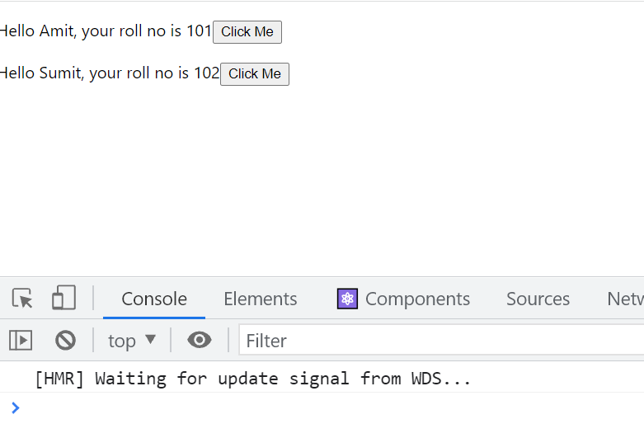
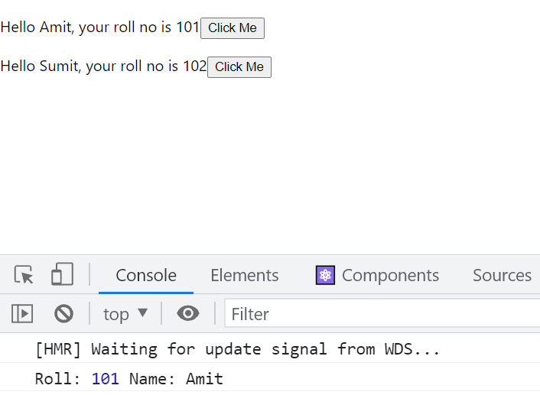
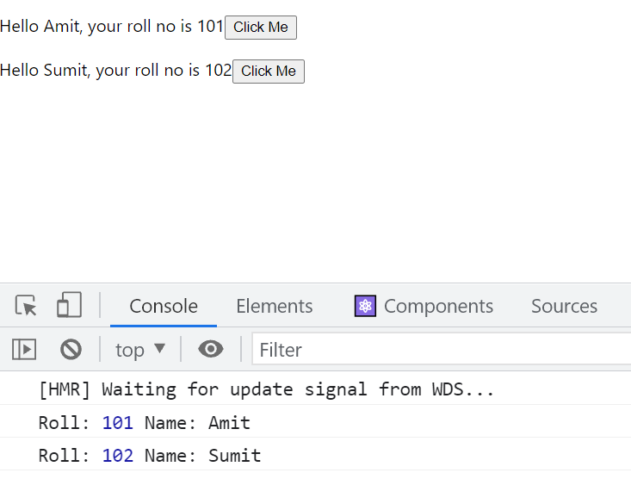
Desired Output
Initial Output
After clicking first button
After clicking second button

Slide 12
Solution
Student.js
import React, { Component } from "react";
class Student extends Component {
handleClick(roll, name, e) {
console.log("Roll:", roll, "Name:", name);
}
handleClickArg = (e) => {
this.handleClick(this.props.roll, this.props.name,e);
};
render() {
return (
<p>
Hello {this.props.name}, your roll no is {this.props.roll}
<button onClick={this.handleClickArg}>Click Me</button>
</p>
);
}
}
export default Student;

Slide 13
Solution
App.js
import React, { Component } from "react";
import Student from "./Student";
class App extends Component {
render() {
return (
<div>
<Student roll={101} name={"Amit"} />
<Student roll={102} name={"Sumit"} />
</div>
);
}
}
export default App;

Slide 14
Passing Anonymous Function To onClick
Instead of routing the call to handleClick() through an extra method , we can simply pass an arrow function to the onClick property while rendering the Button
This means that we can remove the intermediate function handleClickArg() and put its code directly in onClick as arrow function

Slide 15
Solution
Student.js
import React, { Component } from "react";
class Student extends Component {
handleClick(roll, name, e) {
console.log("Roll:", roll, "Name:", name);
}
render() {
return (
<p>
Hello {this.props.name}, your roll no is {this.props.roll}
<button
onClick={(e) => this.handleClick(this.props.roll, this.props.name, e)}
>
Click Me
</button>
</p>
);
}
}
export default Student;

Slide 16
Passing Argument Through bind()
If we recall the syntax of bind() , then we can see that it allows us to pass extra arguments after “this” .
fn.bind(thisArg,<optional arguments>)
All these arguments are sent as parameters to the event handler function when the event is fired

Slide 17
Solution
Student.js
import React, { Component } from "react";
class Student extends Component {
handleClick(roll, name, e) {
console.log("Roll:", roll, "Name:", name);
}
render() {
return (
<p>
Hello {this.props.name}, your roll no is {this.props.roll}
<button
onClick={this.handleClick.bind(
this,
this.props.roll,
this.props.name
)}
>
Click Me
</button>
</p>
);
}
}
export default Student;

Slide 18
Exercise
Create an app with the following files:
MyClicker.js: This file should contain following members:
a state called counter
handleClick() :Which accepts step and increments the counter accordingly
render() : For rendering 3 Buttons which when clicked get the counter incremented by 1 , 2 or 3 respectively
App.js: This file should render the MyClicker component
index.js: To render the App component

Slide 19

Desired Output
Initial Output

Slide 20

Desired Output
After clicking first button

Slide 21

Desired Output
After clicking sec button

Slide 22

Desired Output
After clicking third button

Slide 23
Shopping Cart Project
Create a Shopping Cart App which should do the following:
Display a list of product names as well as a delete button with each product
These product names will be passed from App.js
On clicking a button the corresponding product must be deleted

Slide 24
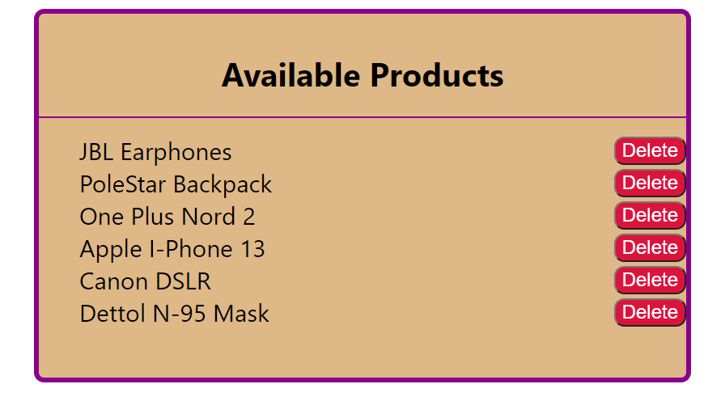
Desired Output
Initial Output

Slide 25
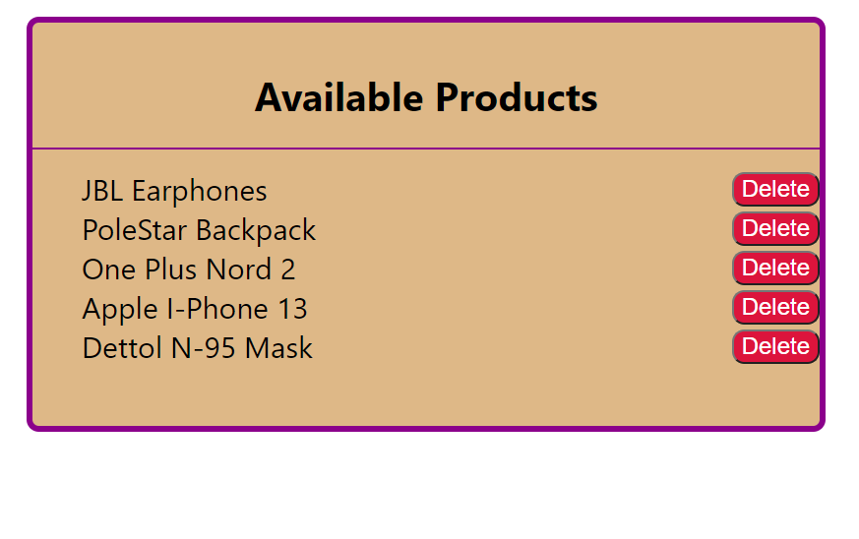
Desired Output
After clicking delete button of Cannon DSLR

Slide 26
The Concept Of “key”
In the previous exercise or any other React app where we have rendered a list using map() method , we can notice that React always gives us a warning:
Warning: Each child in a list should have a unique "key" prop
So now lets discuss what is this warning all about and how we can remove it.

Slide 27
So What Is a “key” ?
Simply put, a key is a prop that is passed in child elements of a list in order to:
Identify which elements are added.
Identify which elements are updated.
Identify which elements are removed.
Hence, key serves as identification for an element just like how Aadhar Card is used to identify people.

Slide 28
How Do We Create A “key” ?
We can easily add a key to list elements like so:
<li key="1">first</li>
<li key="2">second</li>
<li key="3">third</li>
Key should be a unique identifier so that each element can be identified properly.
Therefore, it is recommended to use some uniquely generated id as the key.

Slide 29
Updating Our Product Component
In our previous exercise , we can pass the prop key while creating <Product> component, as shown below
<Product key={item} value={item} remove={this.deleteItem} />
Since key has to be unique so we are using item name itself as the key

Slide 30
Few Important Points
Make sure that every item in the list has a unique key.
It is prefered to not use indexes as a key unless we know for sure that the list is a static list (no additions/re-ordering/removal to the list).
Never use any unstable keys like Math.random() to generate a key.
React will run into performance degradation and unexpected behaviour if unstable keys are used.

Slide 31
Few Important Points
Keys are not the same as props, only the method of assigning a “key” to a component is the same as that of props.
Keys are internal to React and can not be accessed from inside of the component like props

